Slide 1
BoPRC R Course
Lesson 2 – Introduction to Internal Packages

Slide 2

Any questions, comments, or feedback from session 1?

Slide 3


Slide 4
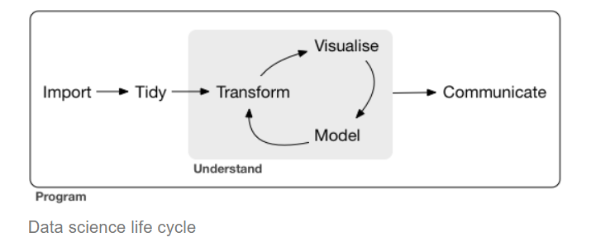

Tidyverse
https://www.tidyverse.org/
Collection of R packages
Aims to fix many of core R's structural problems
Common design and data philosophy
Designed to work together, but integrate seamlessly with other parts of R
Hadley Wickham

Slide 5
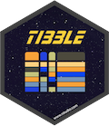

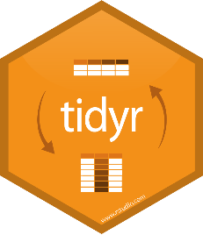

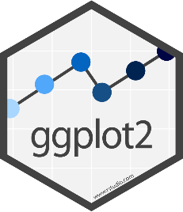
Tidyverse Packages
Tibble - data storage
ReadR - reading data from files
TidyR - Model data correctly
DplyR - Manipulate and filter data
Ggplot2 - Draw figures and graphs

Slide 6
The pipe operator: %>%
Takes the data on its left and makes it the first argument to a function on its right.
> select(trumpton,-LastName)
# A tibble: 7 x 4
FirstName Age Weight Height
<chr> <dbl> <dbl> <dbl>
1 Chris 26 90 175
2 Adam 32 102 183
3 Daniel 18 88 168
4 Chris 48 97 155
5 Carl 28 91 188
6 Liam 35 94 145
7 Doug 31 89 164
> trumpton %>% select(-LastName)
# A tibble: 7 x 4
FirstName Age Weight Height
<chr> <dbl> <dbl> <dbl>
1 Chris 26 90 175
2 Adam 32 102 183
3 Daniel 18 88 168
4 Chris 48 97 155
5 Carl 28 91 188
6 Liam 35 94 145
7 Doug 31 89 164

Slide 7
Example code structure
Data %>%
filter(column1 == “X”) %>%
select(column1, column3, column5) %>%
DO SOMETHING ELSE (e.g., create a plot)…
Import
Tidy/Transform

Slide 8
Plotting figures and graphs with ggplot
ggplot is the plotting library for tidyverse
Powerful
Flexible
Follows the same conventions as the rest of tidyverse
Data stored in tibbles
Data is arranged in 'tidy' format
Tibble is the first argument to each function

Slide 9
Tibbles are nicer dataframes
> head(as.data.frame(data))
Probe Chromosome Start End Probe Strand Feature
1 AL645608.2 1 911435 914948 + AL645608.2
2 LINC02593 1 916865 921016 - LINC02593
3 SAMD11 1 923928 944581 + SAMD11
4 TMEM51-AS1 1 15111815 15153618 - TMEM51-AS1
5 TMEM51 1 15152532 15220478 + TMEM51
6 FHAD1 1 15247272 15400283 + FHAD1
Description
1 novel transcript
2 long intergenic non-protein coding RNA 2593 [Source:HGNC Symbol;Acc:HGNC:53933]
3 sterile alpha motif domain containing 11 [Source:HGNC Symbol;Acc:HGNC:28706]
4 TMEM51 antisense RNA 1 [Source:HGNC Symbol;Acc:HGNC:26301]
5 transmembrane protein 51 [Source:HGNC Symbol;Acc:HGNC:25488]
6 forkhead associated phosphopeptide binding domain 1 [Source:HGNC Symbol;Acc:HGN

Slide 10
Tibbles are nicer dataframes
> head(as_tibble(data))
# A tibble: 6 x 12
Probe Chromosome Start End `Probe Strand` Feature ID Description
<chr> <dbl> <dbl> <dbl> <chr> <chr> <chr> <chr>
1 AL64~ 1 9.11e5 9.15e5 + AL6456~ ENSG~ novel tran~
2 LINC~ 1 9.17e5 9.21e5 - LINC02~ ENSG~ long inter~
3 SAMD~ 1 9.24e5 9.45e5 + SAMD11 ENSG~ sterile al~
4 TMEM~ 1 1.51e7 1.52e7 - TMEM51~ ENSG~ TMEM51 ant~
5 TMEM~ 1 1.52e7 1.52e7 + TMEM51 ENSG~ transmembr~
6 FHAD1 1 1.52e7 1.54e7 + FHAD1 ENSG~ forkhead a~
# ... with 4 more variables: `Feature Strand` <chr>, Type <chr>, `Feature
# Orientation` <chr>, Distance <dbl>

Slide 11
Code structure of a ggplot graph
Start with a call to ggplot()
Pass the tibble of data
Say which columns you want to use
Say which graphical representation you want to use
Points, lines, barplots etc
Customise labels, colours annotations etc.

Slide 12
Geometries and Aesthetics
Geometries are types of plot
geom_point() Point geometry, (x/y plots, stripcharts etc)
geom_line() Line graphs
geom_bar() Barplots
geom_boxplot() Box plots
geom_histogram() Histogram plots
Aesthetics are ways to change the appearance of data in a plot
Colour
Size
Angle
Shape

Slide 13
Example code structure
Data %>%
filter(column1 == “X”) %>%
select(column1, column3, column5) %>%
ggplot(aes(x= column1, y= column5, colour= column3) +
geom_point() +
scale_y_log10() +
theme_bw()
dplyr
ggplot2
Visualise

Slide 14


BoPRC’s Internal Packages

Slide 15
What is an Internal Package?
A package is a collection of functions, data, and documentation bundled together to extend the capabilities of R (e.g., ggplot2).
An internal package is a package that has been built by BoPRC staff for use within the organisation.
Not publicly available.
Can be amended or developed further.
Can have bugs due to lack of maintenance.
There are five internal packages:
aquarius2018, BoPRC2025, LWPTrends,
Dataservices, hydrotel.

Slide 16
aquarius2018
Designed and built by Darren Gerretzen and James Dare in 2018.
Maintained by James Dare and Max Mackay.
Provides access to BoPRC’s Aquarius database.
Primary functions include:
AQMultiExtractFlat()
getdata()
searchlocationid()
datasets()
LocationWQParameters().
Github link: https://github.com/JamesBOPRC/aquarius2018

Slide 17
BoPRC2025
Designed and built by James Dare and Melissa Goldsworthy.
Numerous revisions: 2018, 2022, 2025.
Maintained by James Dare.
Provides a series of functions that are core to BoPRC’s BAU.
Functions are broadly grouped into:
Generic - not specific to any analysis.
Bathing - analysing bathing WQ.
Site Look-up – returns SiteID’s for a project type.
NPS-FM – assesses against the NPS-FM.
Github link: https://github.com/JamesBOPRC/BoPRC2025

